Slide 1
Collisions/Momentum/Impulse

Slide 2
Collisions – Characteristics
The term collision represents an event during which two particles come close to each other and interact by means of forces.
  May involve physical contact, but must be generalized to include cases with interaction without physical contact
The interaction forces are assumed to be much greater than any external forces present.
  This means the impulse approximation can be used.

Slide 3
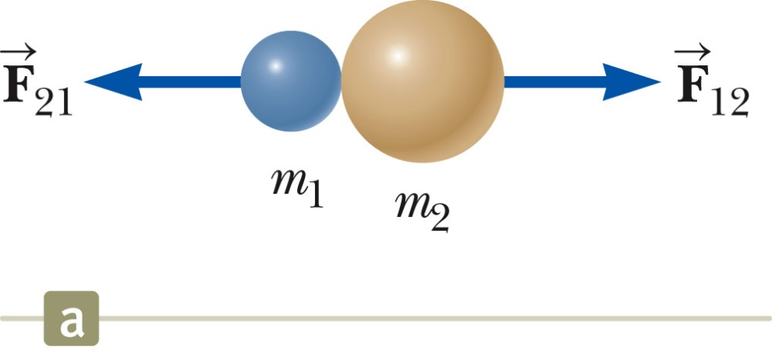
Collisions – Example 1
Collisions may be the result of direct contact.
The impulsive forces may vary in time in complicated ways.
  This force is internal to the system.
Momentum is conserved.

Slide 4
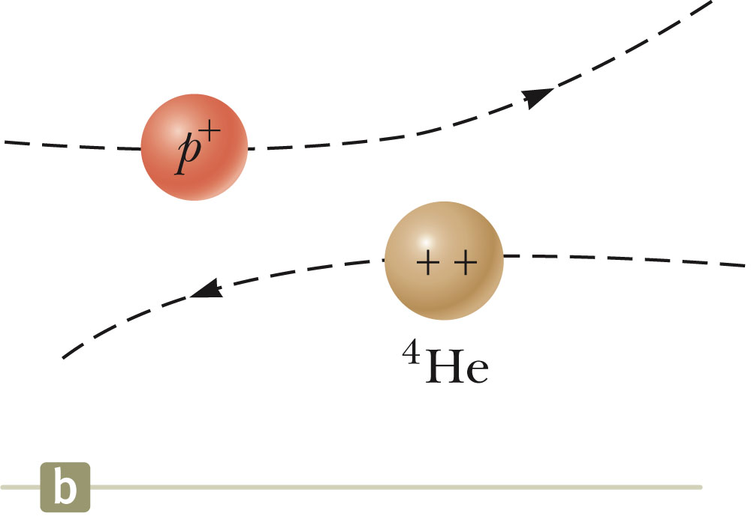
Collisions – Example 2
The collision need not include physical contact between the objects.
There are still forces between the particles.
This type of collision can be analyzed in the same way as those that include physical contact.

Slide 5
Types of Collisions
In an elastic collision, momentum and kinetic energy are conserved.
  Perfectly elastic collisions occur on a microscopic level; objects don’t stick together after collision
  In macroscopic collisions, only approximately elastic collisions actually occur.
    Generally some energy is lost to deformation, sound, etc.
    There must be no transformation of kinetic energy into other types of energy within the system.
In an inelastic collision, kinetic energy is not conserved, although momentum is still conserved.
  If the objects stick together after the collision, it is a perfectly inelastic collision.

Slide 6
Collisions, cont.
In an inelastic collision, some kinetic energy is lost, but the objects do not necessarily stick together.
Momentum is conserved in all collisions

Slide 7
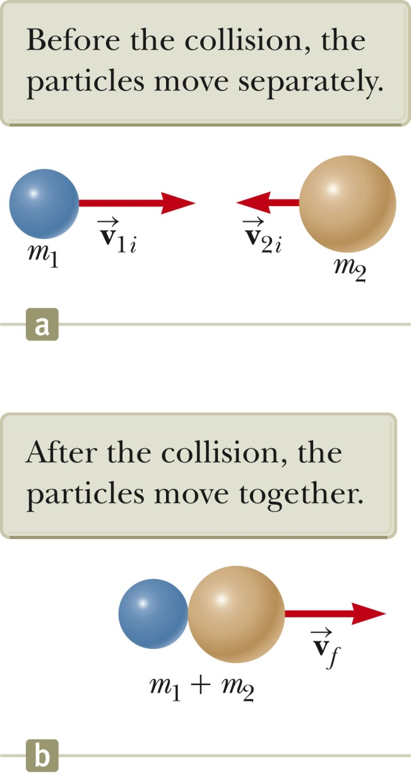
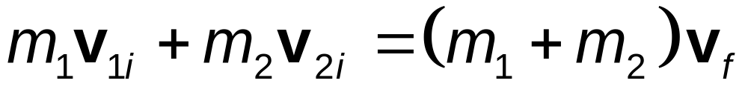
Perfectly Inelastic Collisions
Momentum of an isolated system is conserved in any collision, so the total momentum before the collision is equal to the total momentum of the composite system after the collision.
Since the objects stick together, they share the same velocity after the collision.

Slide 8
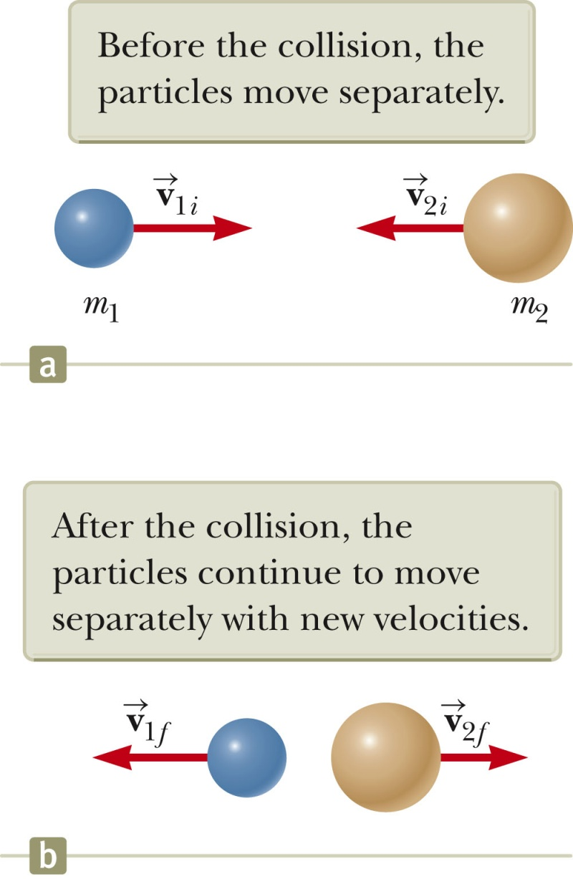
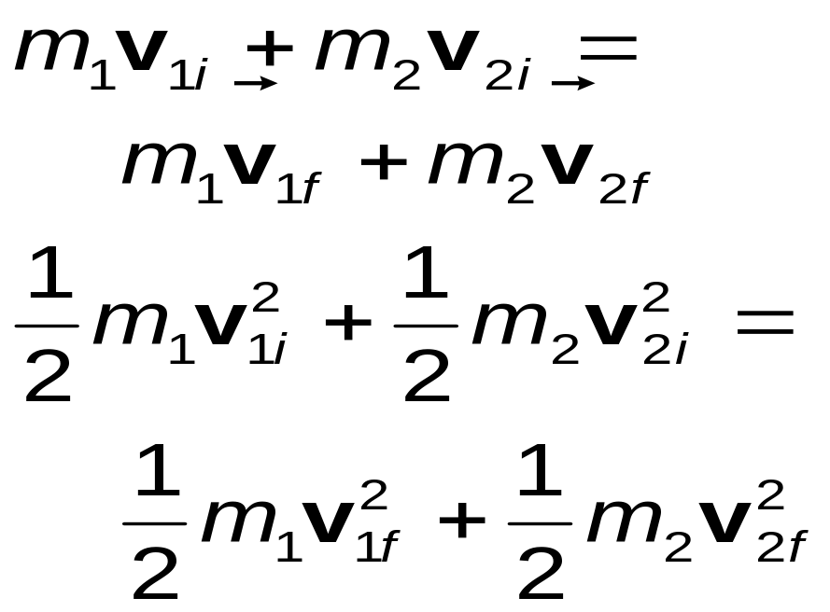
Elastic Collisions
Both momentum and kinetic energy are conserved.
Typically, there are two unknowns to solve for and so you need two equations.

Slide 9
Elastic Collisions, cont.
The kinetic energy equation can be difficult to use.
With some algebraic manipulation, a different equation can be used.
  v_{1i} – v_{2i} = v_{1f} + v_{2f}
This equation, along with conservation of momentum, can be used to solve for the two unknowns.
  It can only be used with a one-dimensional, elastic collision between two objects.
  Using this equation eliminates the need for using an equation with quadratic terms (from the kinetic energy equation).
Remember to use the appropriate signs for all velocities.

Slide 10
Elastic Collisions, final
Example of some special cases:
  m₁ = m₂ – the particles exchange velocities
  When a very heavy particle collides head-on with a very light one initially at rest, the heavy particle continues in motion unaltered and the light particle rebounds with a speed of about twice the initial speed of the heavy particle.
  When a very light particle collides head-on with a very heavy particle initially at rest, the light particle has its velocity reversed and the heavy particle remains approximately at rest.

Slide 11
Problem-Solving Strategy: One-Dimensional Collisions
Conceptualize
  Image the collision occurring in your mind.
  Draw simple diagrams of the particles before and after the collision.
  Include appropriate velocity vectors.
Categorize
  Is the system of particles isolated?
  Is the collision elastic, inelastic or perfectly inelastic?

Slide 12
Problem-Solving Strategy: One-Dimensional Collisions
Analyze
  Set up the mathematical representation of the problem.
  Solve for the unknown(s).
Finalize
  Check to see if the answers are consistent with the mental and pictorial representations.
  Check to be sure your results are realistic.

